Slide 1
Comprehensive Overview of Large Language Models

Slide 2
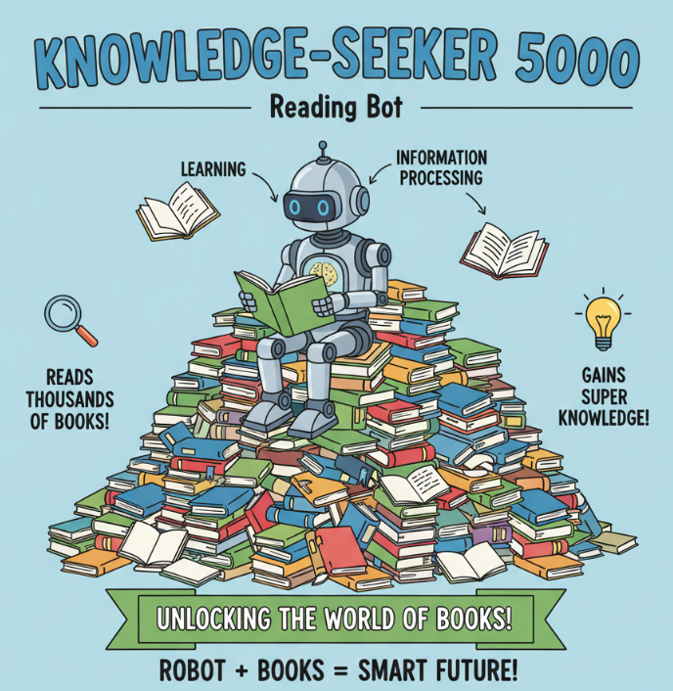
What is a Large Language Model (LLM)?
Imagine a computer program that has read almost every book, website, and article in the world. An LLM is a type of Artificial Intelligence (AI) trained on massive amounts of text to understand and generate human language. It's not actually 'thinking' like you do; it's a giant pattern-matching machine.
Think of a parrot that has memorized the entire dictionary and encyclopedia. It can repeat sentences and combine words in new ways, but it doesn't always understand the deep meaning of what it is saying.

Slide 3
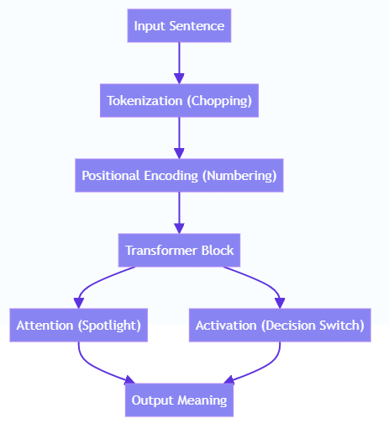
LLM Mechanism

Slide 4
Training Data: Feeding the Brain
To make an LLM smart, scientists feed it huge amounts of text called 'Training Data'. This includes Wikipedia, news articles, code, and books. The model analyzes this data to learn grammar, facts, and how words fit together.
Example: If you wanted to learn to write a mystery novel, you might read 100 mystery books first. The LLM does this, but it reads billions of things so it knows how to write in any style!

Slide 5
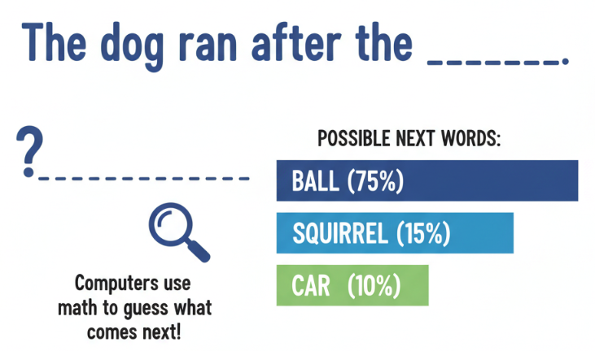
Next-Word Prediction
LLMs work by guessing. When you type a sentence, the LLM looks at the words and calculates the probability of what word comes next. It picks the most likely word to complete the pattern.
Example: If you say 'The cat sat on the...', the LLM guesses 'mat' (90% chance), 'floor' (5% chance), or 'roof' (5% chance). It builds sentences one word at a time based on these guesses.

Slide 6
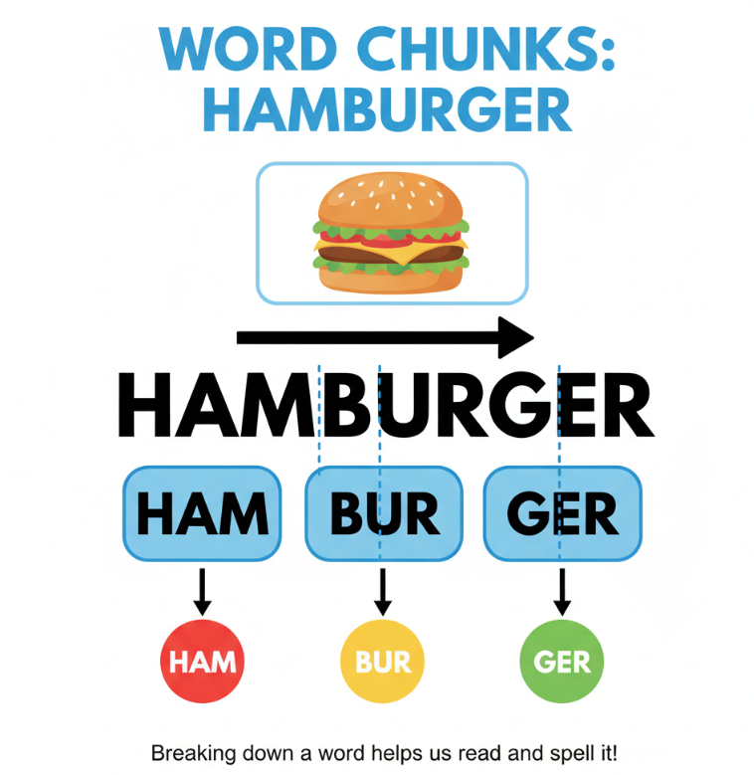
Tokens: Pieces of Words
Computers don't read whole words like we do. They break text into smaller chunks called 'Tokens'. A token can be a whole word, part of a word, or even a single letter. This helps the computer process language faster.
Example: The word 'Smart' might be one token, but 'Smarter' might be broken into two tokens: 'Smart' + 'er'. This is like using Lego bricks to build different words.

Slide 7
Encoding: The Map of Order
Computers look at all the words in a sentence at the same time. To stop them from getting confused, we give each token a number that acts like a seat number at a concert, so the computer knows which word comes first, second, or last.
Without this, the computer wouldn't know the difference between 'The dog bit Johnny' and 'Johnny bit the dog'.

Slide 8
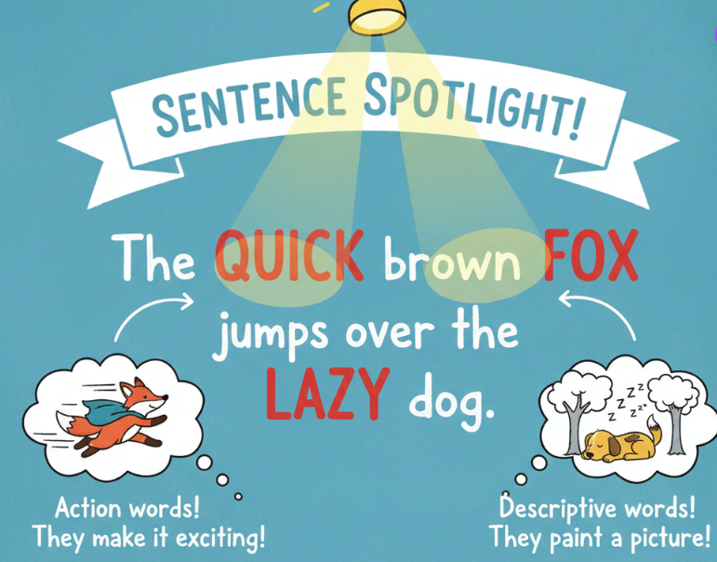
Attention Mechanism: The Spotlight
This is the 'brain' power of the model. When the computer reads a word, it shines a 'spotlight' on other related words in the sentence to understand the meaning. It decides which words are friends and should be paid attention to.
For example: In the sentence 'The bank is by the river', the computer focuses on the word 'river' to know that 'bank' means the ground by the water, not a place for money.

Slide 9
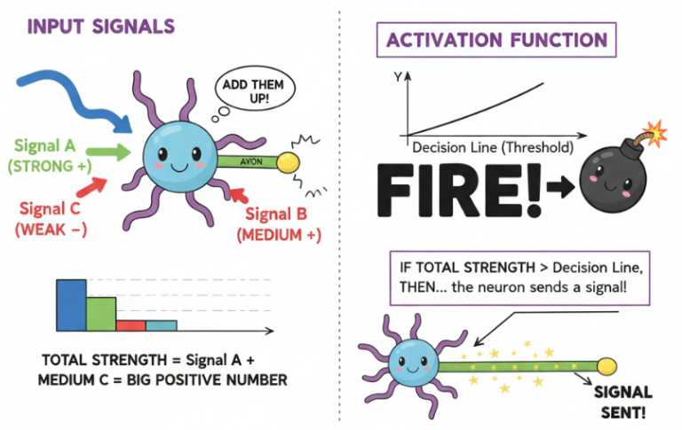
Activation Functions: The Brain Switches
Inside the AI's brain, there are math equations (like ReLU or GeLU) that act like traffic lights. They decide if a piece of information is important enough to pass through to the next layer or if it should be stopped.
Example: Imagine a light switch that only turns on if you shout loud enough. If the information is 'loud' (important), the switch turns on!

Slide 10
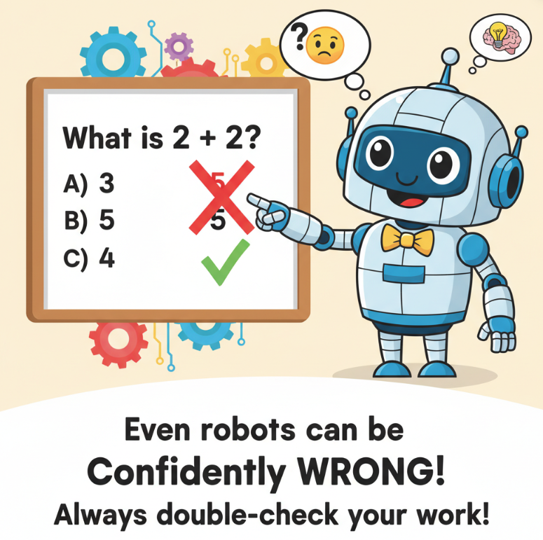
Hallucinations: When AI Makes Mistakes
Sometimes, LLMs make up facts confidently. Because they are just predicting words, they can write something that looks true but is actually false. We call this a 'Hallucination'.
Example: If you ask an LLM about a movie that doesn't exist, it might invent a plot, a director, and actors for it just to be helpful, even though none of it is real.

Slide 11
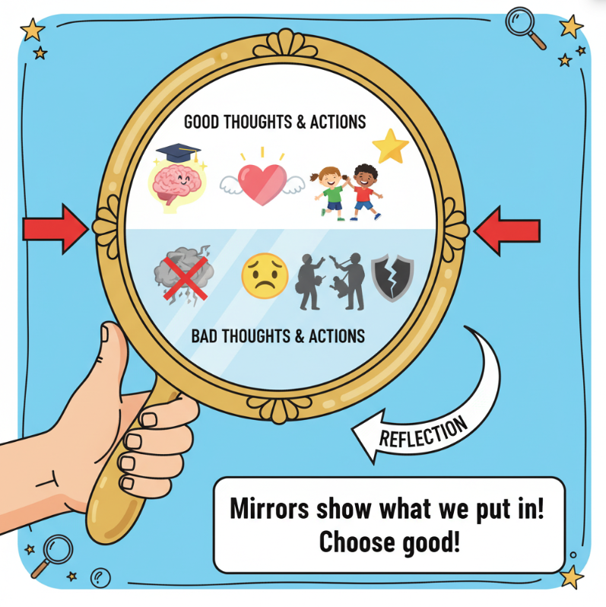
Bias and Ethics
Since LLMs learn from the internet, they also learn the bad stuff found there. If the training data contains stereotypes or mean comments, the AI might repeat them. We must use these tools responsibly.
Example: If most old stories say that only men can be doctors, the AI might wrongly guess that 'doctor' usually refers to a 'he' instead of a 'she' or 'they'. Keep this in mind to be a principled thinker!

